Slide 1
A Video Description of the
Reading Rainbow Cupcake

Slide 2
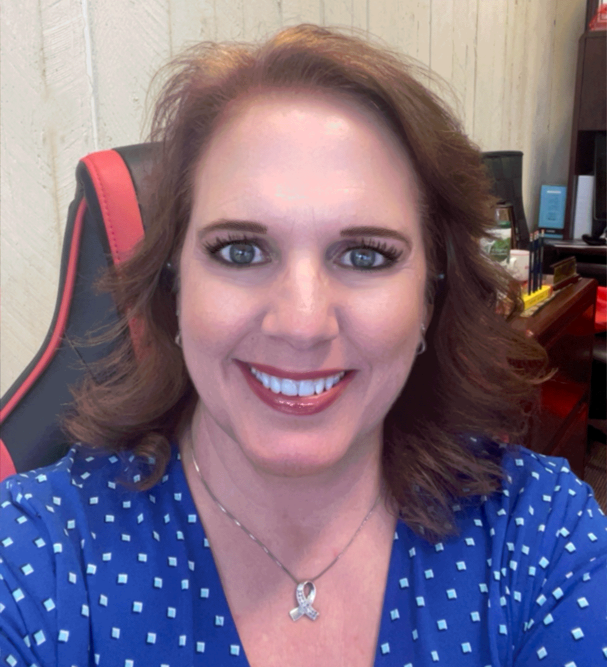
Speaker
Kristi L. Santi, Ph.D.
Special Populations

Slide 3
Introductions
Project Staff
Kristi L. Santi, Ph.D.
Jacquie Hawkins, Ed.D.
Coleen D. Carlson, Ph.D.
David J. Francis, Ph.D.
Jack Fletcher, Ph.D.
Elsa Cárdenas-Hagan, Ed.D.
Ken Nieser, M.A.
Griselda Barcenas, M.A.
Houston Christian University
Shawn Kent, Ph.D.

Slide 4
AGENDA – Reading Rainbow Cupcake
Focus Topic for Meeting: The Reading Rainbow Cupcake
Graphic The Reading Rainbow Cupcake
What does the Reading Rainbow Cupcake look like in practice?
Campus PDSA – Reading Rainbow Cupcake

Slide 6
Improvement Science
Work is Problem Specific and User-Centered
Focus on Variation in Performance
Adopt a Systems Perspective
Measures ARE Necessary to Improve at Scale
Disciplined Inquiry Drives Improvement
NICs can Accelerate Improvement
Six
Pillars

Slide 7
What does the RRC mean in practice?
What do I need to remember about the RRC graphic? ​
​
Reading Skills of students are not taught in isolation – they must be integrated.​
Basic Literacy Skills and Instructional Content must be connected during instruction to make learning stick.
All Literacy Skills must be addressed to ensure successful motivated readers.
FIVE key takeaways ​from the RCC.
​
Content of Systems​ must connect current knowledge with new learning.
Schedule of Instruction​ must allow students to build connections among the systems.
Co-Location for Learning​ is essential to help students to see the connections between the systems.
Integration of Learning must occur often and appear seamless.​
Generalization of Learning can be promoted across time, across content, to promote lifelong learning.
Just-In-Time Instructional Change​

Slide 8
CAMPUS PDSA: RCC
PLAN
DO
Curriculum Alignment
Review reading programs to identify areas where student support can be strengthened and identify what is already working.
Collect
Use the state standards to identify the areas for growth.
Progress Monitor reading skills of struggling readers.
P
D
ACT
STUDY/SHARE
S
A
Set improvement goals
Fill in the gaps with evidenced-based practices
Coordinated instruction/assessments
Instructional teams/collaboration
Any challenges are noted
Review the data collected
Support/Instructional changes that are identified and implemented.
Revised lesson plans to ensure the active learning opportunities are present.

Slide 9
For more information please visit:
http://dyslexia.times.uh.edu
AIIPaT Dyslexia is supported in part by the Model Demonstration Project PR: H326M190008 from the Office of Special Education Programs. The dissemination of research-based information about dyslexia is supported by several sources. The content disseminated here is solely the responsibility of the authors and does not necessarily represent the official views of OSEP, the U.S. Department of Education, or any of our other funding agencies..

