Slide 1
A Video Description of the
CORE CONTENT Graphic

Slide 2
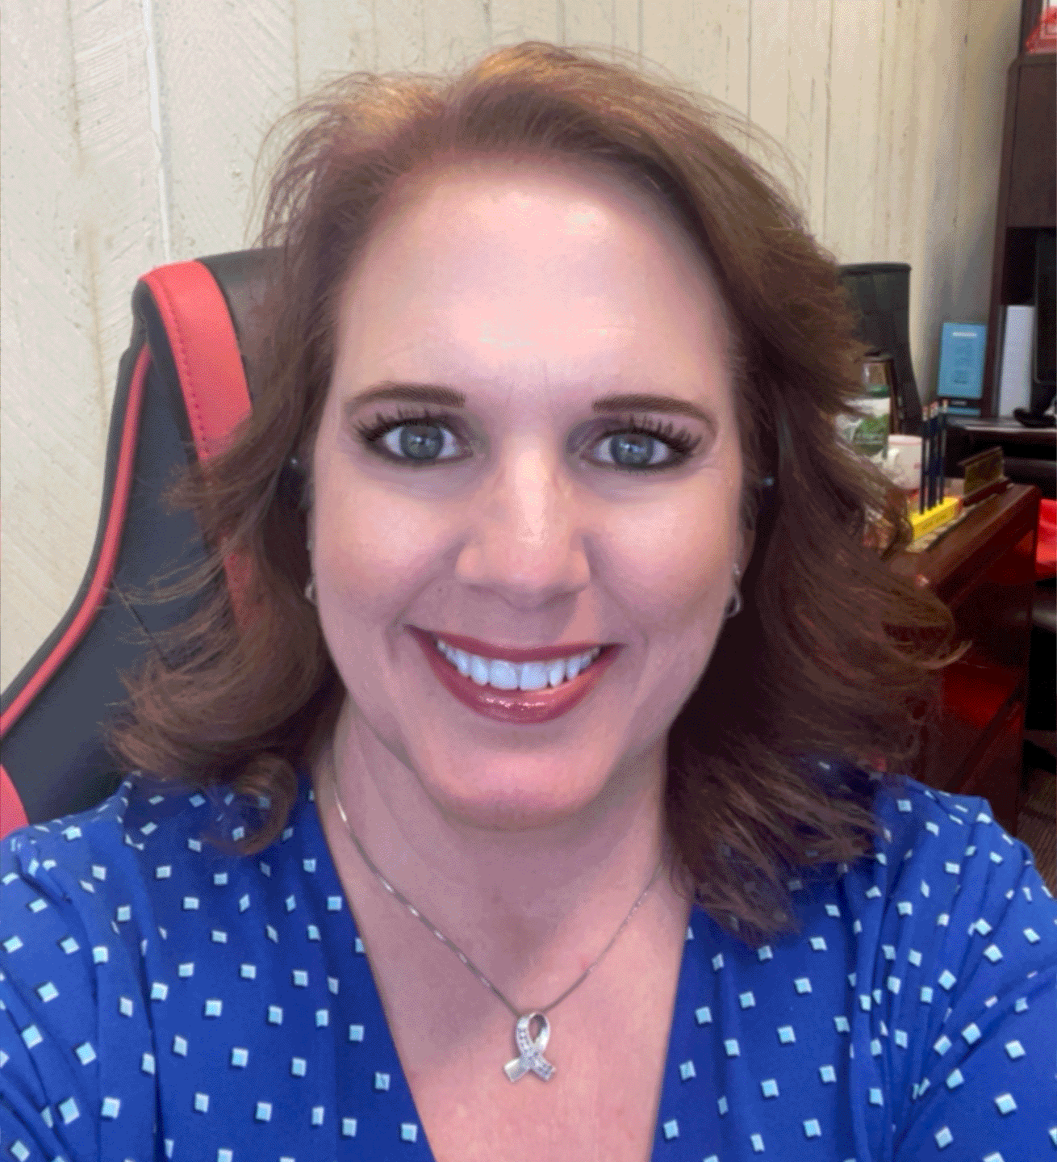
Speaker
Kristi L. Santi, Ph.D.
Special Populations

Slide 3
Introductions
Project Staff
Kristi L. Santi, Ph.D.
Jacquie Hawkins, Ed.D.
Coleen D. Carlson, Ph.D.
David J. Francis, Ph.D.
Jack Fletcher, Ph.D.
Elsa Cárdenas-Hagan, Ed.D.
Ken Nieser, M.A.
Griselda Barcenas, M.A.
Houston Christian University
Shawn Kent, Ph.D.

Slide 6
For more information please visit:
http://dyslexia.times.uh.edu
AIIPaT Dyslexia is supported in part by the Model Demonstration Project PR: H326M190008 from the Office of Special Education Programs. The dissemination of research-based information about dyslexia is supported by several sources. The content disseminated here is solely the responsibility of the authors and does not necessarily represent the official views of OSEP, the U.S. Department of Education, or any of our other funding agencies..

