Slide 1
AGENDA – LIFE – The Gift of Literacy
Welcome to the NIC/PLC
Recap of Data Detective materials - PDSA
Focus Topic for Meeting: LIFE - The Gift of Literacy
What Will YOU Give Children?
Graphic LIFE
What does LIFE mean in practice?
Campus PDSA – LIFE
Next Steps at YOUR CAMPUS

Slide 2
NIC
Welcome to your campus Literacy NIC for 2022-2023 What does a network improvement community mean to you?

Slide 3
Improvement Science
Work is Problem Specific and User-Centered
Focus on Variation in Performance
Adopt a Systems Perspective
Measures ARE Necessary to Improve at Scale
Disciplined Inquiry Drives Improvement
NICs can Accelerate Improvement
Six
Pillars

Slide 4
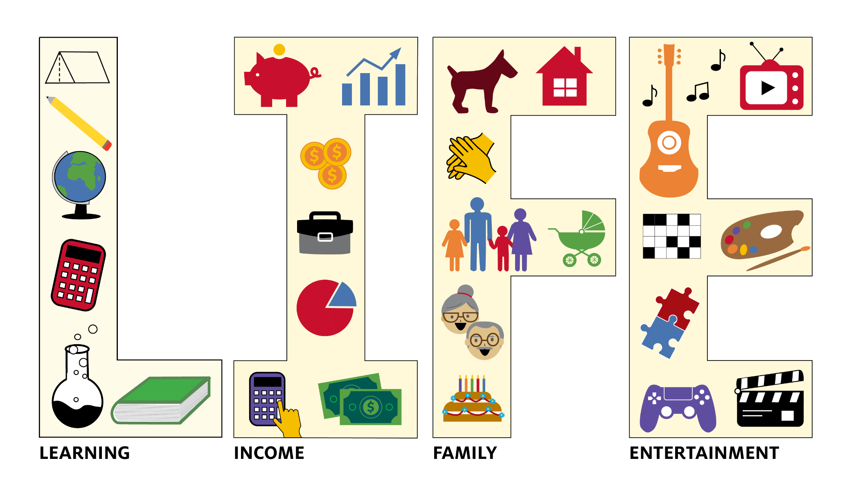
Literacy, Your Gift of LIFE

Slide 5
What does LIFE Mean – In practice?
What do I need to remember about the LIFE graphic? ​
​
Reading Skills IMPACT EVERYTHING
Literacy
Income
Family
Entertainment
SIX key takeaways ​from the LIFE.
​YOUR 20/20 Vision for Reading Instruction for EVERY STUDENT
Good core Reading Skills are essential in the early grades.
Literacy Levels support comprehension in later grades.
Differentiated Reading Instruction by caring educators.
EVERY educator focuses on Reading Skill acquisition and use across ALL content areas.
ALL educators work together on a Network of Support for Literacy.
ALL educators focus on the components of core Reading Skills across all grade levels with a focus on enhancing the Literacy Skills of EVERY student for LIFE.
The Gift You Give Children​

Slide 6
CAMPUS PDSA: LIFE
PLAN
DO
How can YOU support the LIFE of your students? What is your part in the Gift of Literacy?
Collect
How will you explain LIFE to others? What are their reactions?
How can you build importance of and urgency for LITERACY?
P
D
ACT
STUDY/SHARE
Set outcome improvement goals
Which students need your Literacy focus? Early grades; Later grades?
Coordinated instruction/assessments
Instructional teams/collaboration
Any challenges are noted
Study the reactions, importance, and urgency outcomes.
How will you share those with the group?
How will you link current Literacy Levels to LIFE outcomes?
S
A

